Slide 1
Health Insurance Cross Sell Prediction AI in Enterprise Systems (AIDI2004)
Harsh Patel (100800197)
Sanket Patel (100800990)
Ramesh Krishna (100766763)

Slide 2
Objectives
Client: Insurance company
Provides Health Insurance to its customers
Predict if existing customers will buy Vehicle Insurance.
Helpful to plan its communication strategy and optimize its business model and revenue.
Information about demographics (gender, age, region code type), Vehicles (Vehicle Age, Damage), Policy (Premium, sourcing channel) available.
Identify right set of customers who would buy the vehicle insurance.

Slide 3
Data Set
https://www.kaggle.com/anmolkumar/health-insurance-cross-sell-prediction
Variable | Definition
id | Unique ID for the customer
Gender | Gender of the customer
Age | Age of the customer
Driving_License | 0 : Customer does not have DL, 1 : Customer already has DL
Region_Code | Unique code for the region of the customer
Previously_Insured | 1 : Customer already has Vehicle Insurance, 0 : Customer doesn't have Vehicle Insurance
Vehicle_Age | Age of the Vehicle
Vehicle_Damage | 1 : Customer got his/her vehicle damaged in the past. 0 : Customer didn't get his/her vehicle damaged in the past.
Annual_Premium | The amount customer needs to pay as premium in the year
PolicySalesChannel | Anonymized Code for the channel of outreaching to the customer ie. Different Agents, Over Mail, Over Phone, In Person, etc.
Vintage | Number of Days, Customer has been associated with the company
Response | 1 : Customer is interested, 0 : Customer is not interested
Total attributes: 12
Number of records: 381109
Numerical variables:3
Categorical variables:9
Tools: Git, Docker, AWS, Heroku
Front end: Streamlit
Algorithm: XGBoost

Slide 4
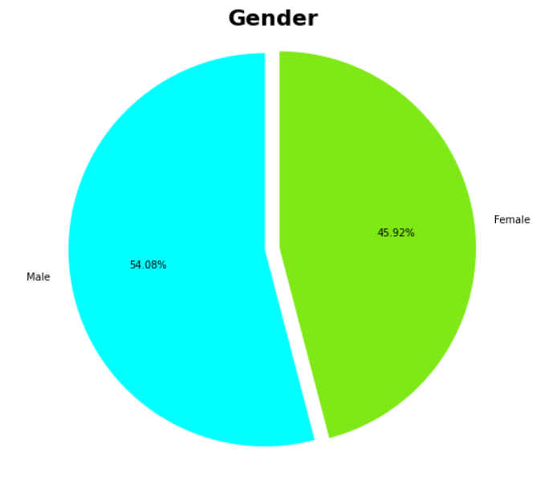
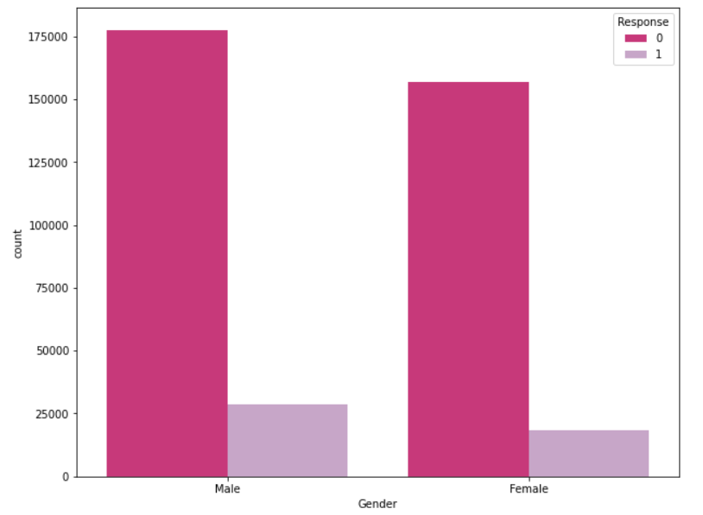
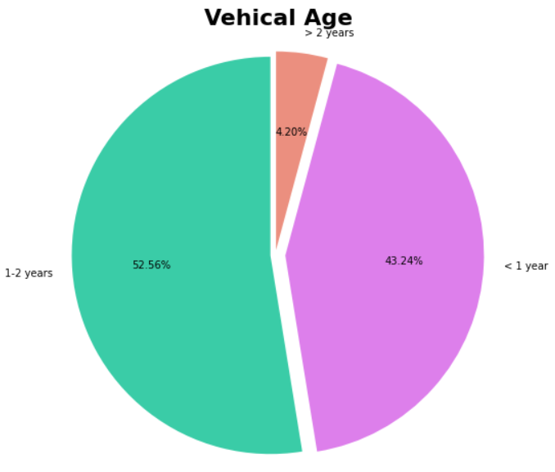
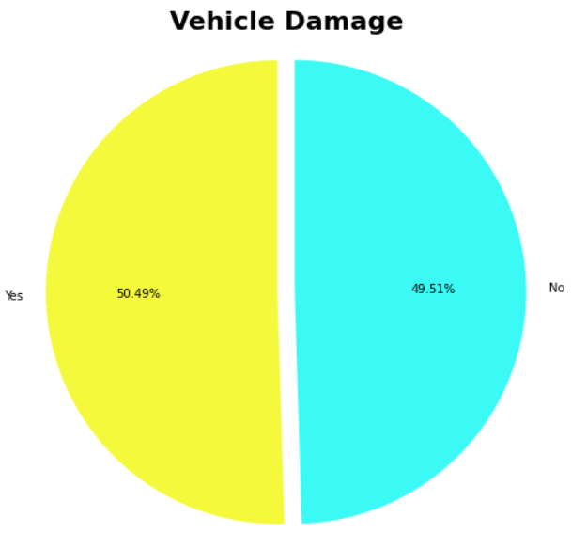
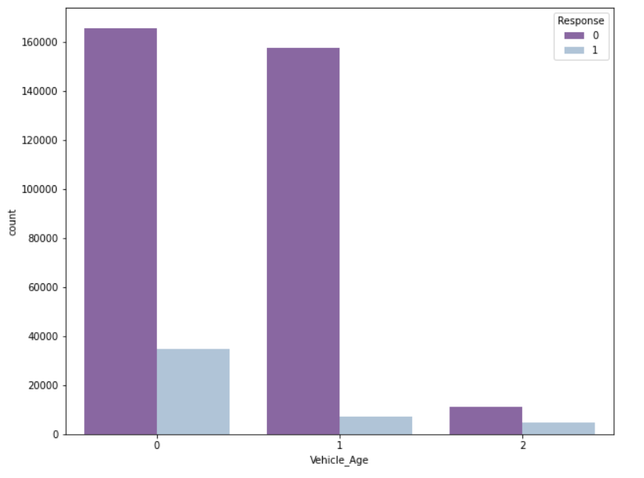
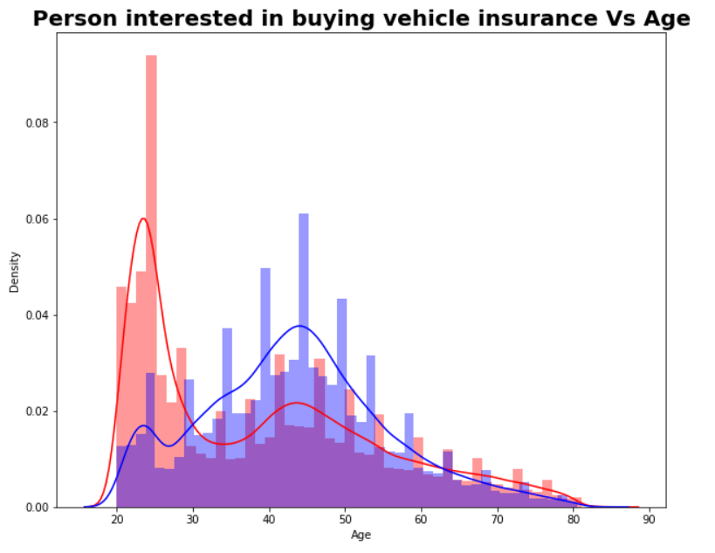
Exploratory Data Analysis

Slide 5
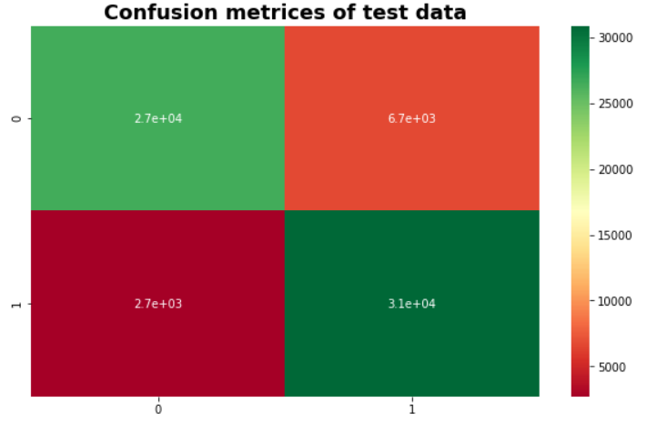
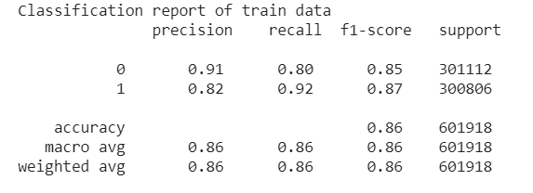
Models & results
Chosen model : XGBoost
Decision Tree
Random Forest
Logistic Regression
KNN Classifier
XGBoostClassifier
GradientBoosting Classifier
CategoricalNB
LinearSVC

Slide 6
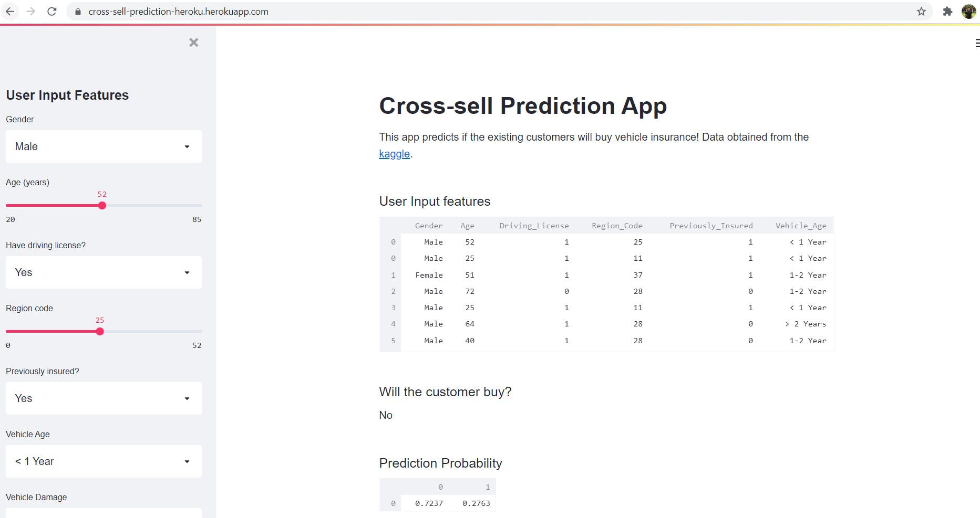
Final Deliverables
A webpage where an analyst enters customer details in different input boxes
Result: Final suggestion to run campaign against this customer or not.

Slide 7
Inference
Steps:
Pickle the xgboost model
Pickle the scaler to scale input values
Append user inputs with dummy file to have a proper encoding
Preprocess the data and select first row.
Generate inference and display results.
Deployment
Frontend: Streamlit (https://streamlit.io/)
Heroku: https://cross-sell-prediction-heroku.herokuapp.com/
AWS & Docker: http://cross.dotslashai.com/

Slide 8
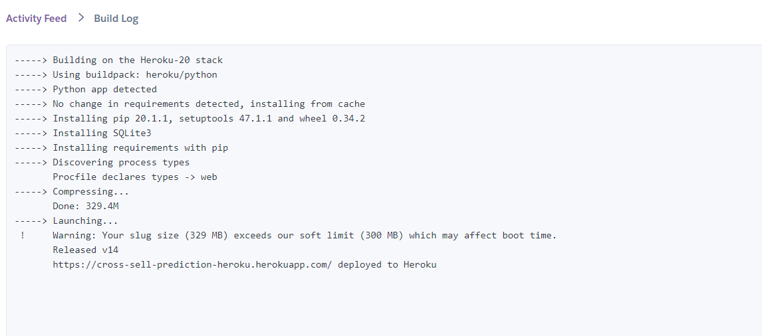
Heroku

Slide 9
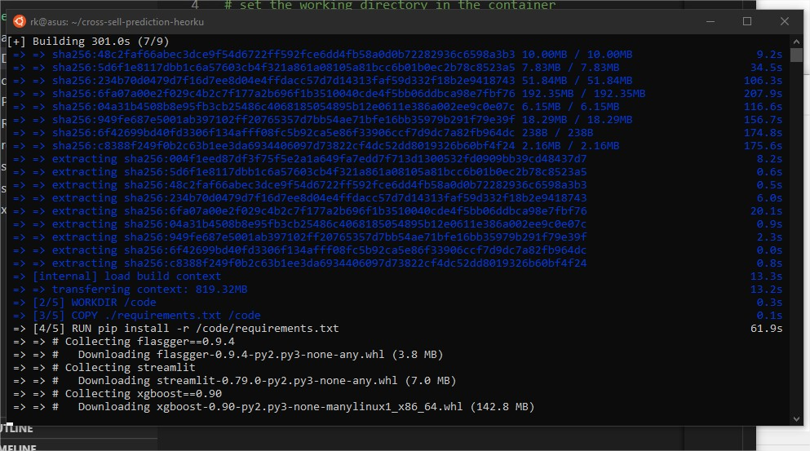
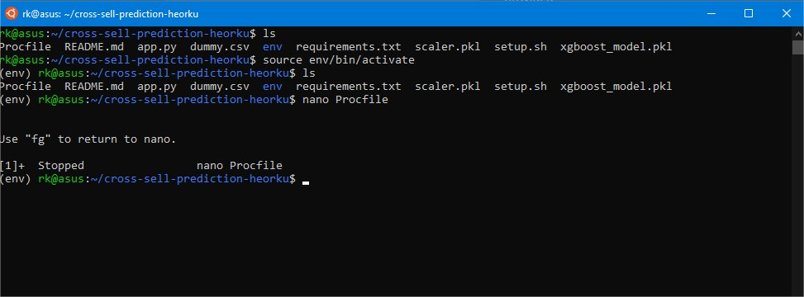
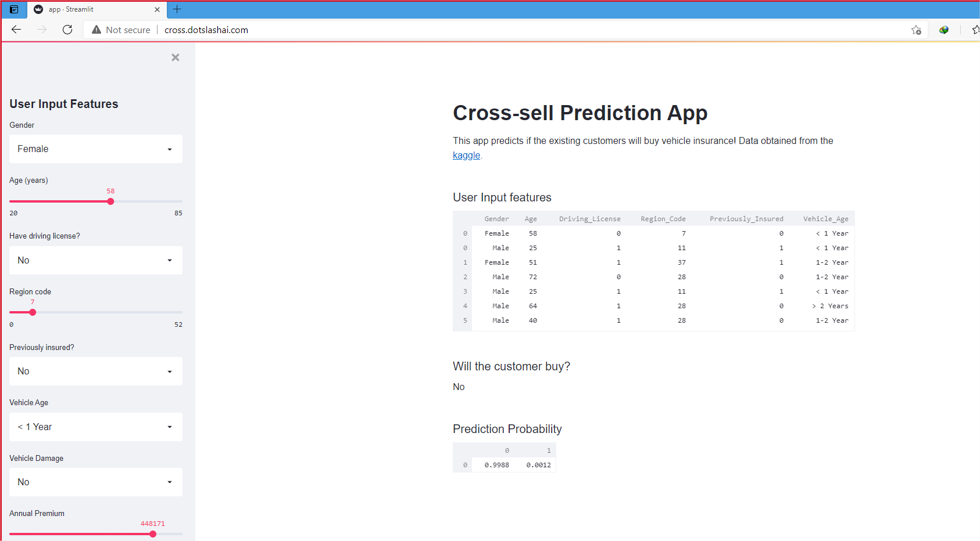
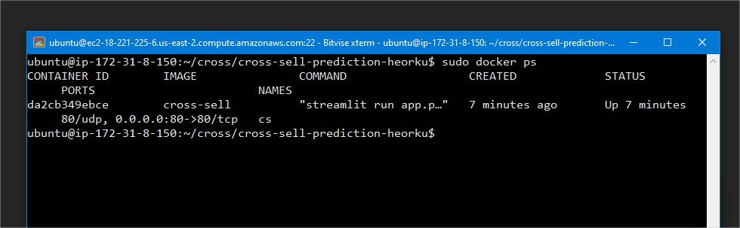
AWS & Docker

Slide 10
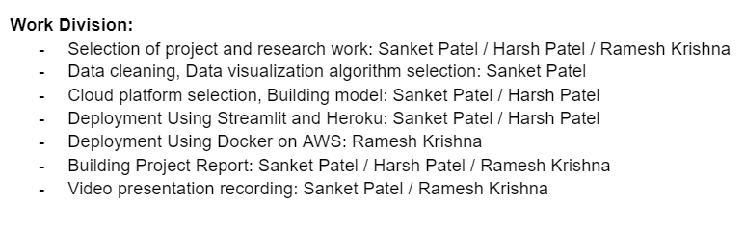
Project Timeline & work division
Deliverable | Time
Data visualization, Data cleaning and Algorithm selection | Week of 8 March to 14 March
Cloud platform selection, Building model and saving model to the cloud service. | Week of 15 March to 21 March
Building front end For publicly use of our application | Week of 22 March to 28 March
Report and Video presentation of project | Week of 29 March to 8 April

Slide 11
Thank you

